Slide 1
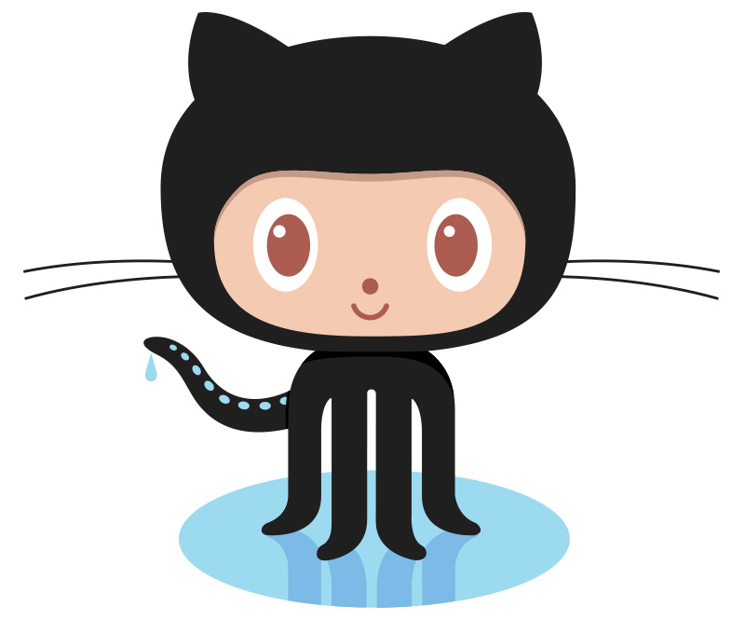
Version Control: Git & GitHub
Maja Grubisic
March 5, 2018

Slide 2
Overview
What is Git?
Why Git?
What is GitHub?
How does it work?
Quick example using Git and GitHub

Slide 3
What is version control?
A system that keeps records of your changes
Allows for collaborative development
Allows you to know who made what changes and when
Allows you to revert any changes and go back to a previous state

Slide 4

What is Git?
Started in 2005
Created by Linus Torvald to ad in Linux kernel development
Git logo:
Notes:
Kernel is the core of any operating system. A kernel is actually a large block of code which keeps the system up and running from the time of booting, till shutdown.

Slide 5
What is Git?
Git is a version control system. It helps you manage work done on projects.
Its original purpose was to help groups of developers work collaboratively on big software projects.
Git manages the evolution of a set of files called a repository or repo in a highly structured way.
It is like the “Track Changes” feature from Microsoft Word, but more rigorous, powerful and scaled up to multiple files.
Notes:
“Git is an application that runs on your computer, like a web browser or a word processor.”
Git has been re-purposed by the data science community.
It can be used to manage a collection of files that make up typical data analytical projects, which consist of data, figures, reports, and source code.
Even someone who is working alone on a project, can benefit from adopting version control.
For new users, the pros of Git only outweigh the cons when you consider the overhead of working with other people, including your future self.
In a Git-based workflow, you document and, optionally, expose your work as you go.
Git’s model of file management can feel uncomfortably rigid, but it enables the distribution of files across different people, computers and time.
Because Git’s model of file management is quite rigid, it is best to pick a first project that involves sharing rapidly evolving files with others. It is tempting to pick a quiet, private project. But if you do, you may never find the benefits of formal version control
compelling enough to cement the new habit.
Git is NOT the only version control system – there are many others e.g. Perforce, Subversion, Mercurial

Slide 6
Why Git? The Benefits of Using Hosted Version Control
Doing your work becomes tightly integrated with organizing, recording and disseminating it. It’s not a separate, burdensome task you are tempted to neglect.
Collaboration is much more structured, with powerful tools for asynchronous work and managing versions.
The marginal effort required to create a web presence for a project in negligible.
Notes:
Why would a statistician use a version control system, such as Git?
And what is the point of hosting your work online e.g. on GitHub? Could the gains possibly justify the inevitable pain?
The Bad News: Git was built neither for the exact usage described here, nor for broad usability. However, there are many helpful tools that mediate your interactions with Git. GitHub itself is a fine example, as is Rstudio.

Slide 7
How does git work? Key Concepts: Snapshots
The way git keeps track of your code history.
Essentially records what all your files look like at a given point in time.
You decide when to take a snapshot, and of what files.
Have the ability to go back to visit any snapshot.
- Your snapshots from later on will stay around, too.
Notes:
It can be complicated at first, but there are a few key concepts

Slide 8
How does git work? Key Concepts: Commit
Commit is the act of creating a snapshot
It can be a noun or verb:
- ‘I commited code’
- ‘I just made a new commit’
Essentially, a project is made of a bunch of commits.

Slide 9
How does git work? Key Concepts: Commit
Commits contain three pieces of information:
1. Information about how the files changed from previously
2. A reference to the commit that came before it
- called the ‘parent commit’
3. A hash code name
- it will look something like:
fb2d2ec5069fc6776c80b3ad6b7cbde3cade4e

Slide 10
How does git work? Key Concepts: Repositories
Repository is often called repo
It is a collection of all the files and the history of those files
It consists of all your commits
It is a place where all your work is stored

Slide 11
How does git work? Key Concepts: Repositories
Repo can exist on a local machine or on a remote server (such as GitHub!).
The act of copying a repository from a remote server is called cloning.
Cloning from a remote server allows teams to work together.

Slide 12
How does git work? Key Concepts: Repositories
The process of downloading commits that don’t exist on your machine from a remote repository is called pulling changes.
The process of adding your local changes to the remote repository is called pushing changes.

Slide 13
How does git work? Key Concepts: Branches
All commits in git live on some branch.
But there can be many, many branches.
The main branch in a project is called the master branch.

Slide 14
What does a typical project look like?
A bunch of commits linked together that live on some branch, contained in a repository.

Slide 15
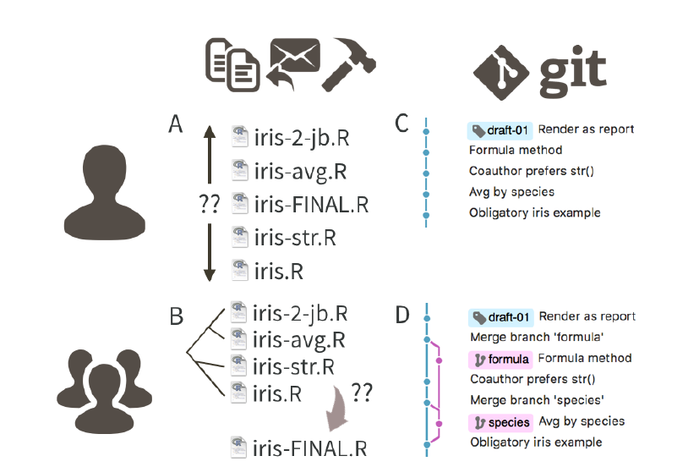
What is Git?
Notes:
You use Git to take snapshots of all the files in a folder. This folder is called a repository or repo.
Many people who don’t use Git unwittingly re-invent a poor man’s version of it. This figure deppicts a hypothetical analysis of the iris data, captured in a single R source file.
Pictures A & B: With informal version control, contributors create derivative copies of iris.R, adding their initials, dates and other descriptors to the file name.
Picture A: Even when working alone, this leads to multiple versions of iris.R of indeterminate relatedness.
Picture B: In collaborative settings based on email distribution, the original file swiftly becomes part of a complicated naming system, so it becomes difficult to resolve which version of the file is the most recent and final.
Pictures C & D: The Git way is to track the evolution of iris.R, through a series of commits, each equipped with an explanatory message.
Picture C: Shows the linear process with development and time flowing from bottom to top.
Picture D: Shows the same history for a common collaborative Git workflow, where contributors work independently but sync regularly to a common version.

Slide 16
What is GitHub?
GitHub complements Git by providing a user interface and distribution mechanism for Git repositories (repos).
Git is the software you will use locally to record changes to a set of files. GitHub is a hosting service that provides a Git-aware home for such projects on the internet.
GitHub is like DropBox or Google Drive, but more structured, powerful and programmatic.
Notes:
GitHub acts as the distributor for a Git-managed project.
This allows others to browse project files, explore their history, sync up with the current version, and perhaps even propose or make changes.
Many operations can be done entirely in the browser, including editing or adding files. It is easy to create a hyperlink to a specific file or location in a file, at a specific version, which can make meta-conversations about project code or reports much more productive.
GitHub also offers granular control over who can see, edit, and administer a project.

Slide 17
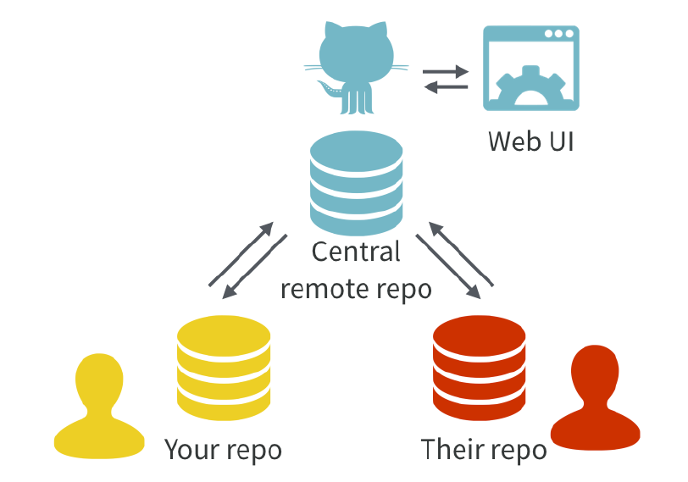
What is GitHub?
Notes:
With Git, all contributors have a copy of the repository (repo), with all files and the full history. It is typical to stay in sync through the use of a central remote repository, such as GitHub. Hosted remotes like GitHub also provide access to the repo through a web browser.
Git stores the whole history of your project.

Slide 18
Initial System Setup
Install Git.
Mac: http://git-scm.com/download/mac
Windows: http://git-scm.com/download/win
Register for a free account with GitHub.
www.github.com

Slide 19
How it works
Repository= your project folder
Commit=save a snapshot

Slide 20
How it works
When you want to take a snapshot of a file or files, you create a commit.

Slide 21
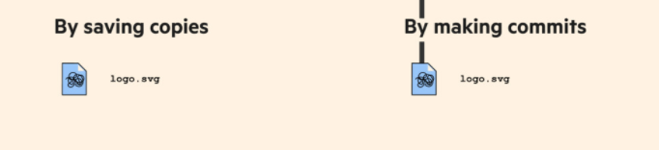
How it works

Slide 22
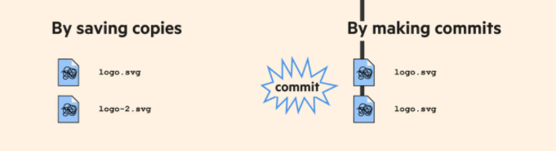
What is Git?

Slide 23
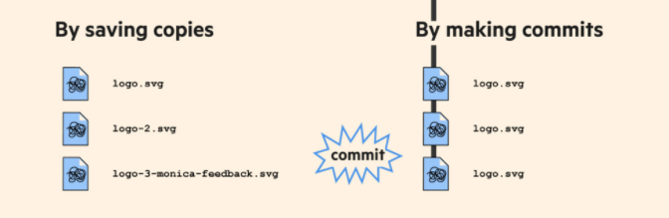
How it works

Slide 24
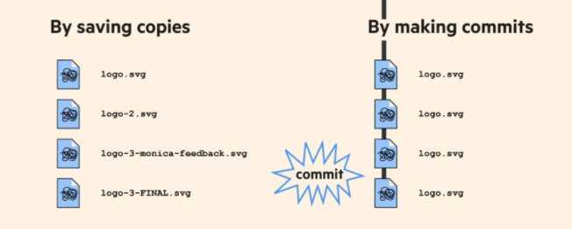
How it works

Slide 25
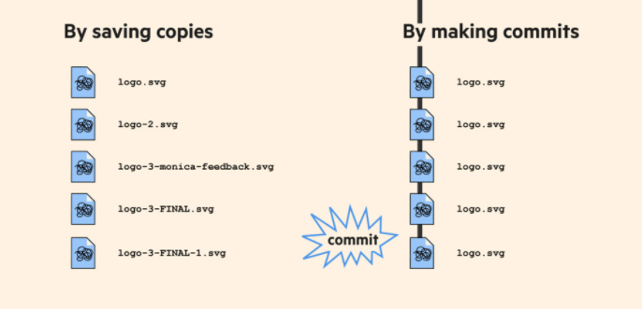
How it works

Slide 26
How it works
When you commit a file or files, some information is saved along with the changes to the file.

Slide 27
References
Bartlett, A. (2016), `Git for humans', Talk at UX Brighton.
URL: https://speakerdeck.com/alicebartlett/git-for-humans
Bryan, J. (2017), ‘Excuse me, do you have a moment to talk about version control?’, PeerJ Preprints.
URS: https://doi.org/10.7287/peerj.preprints.3159v2
Git (n.d.).
URL: https://git-scm.com
GitHub(n.d.)
URL:https://github.com
URL: https://www.slideshare.net/HubSpot/git-101-git-and-github-for-beginners

